Slide 1
CAS ADS Module 3 Project
Nils Sommer

Slide 2
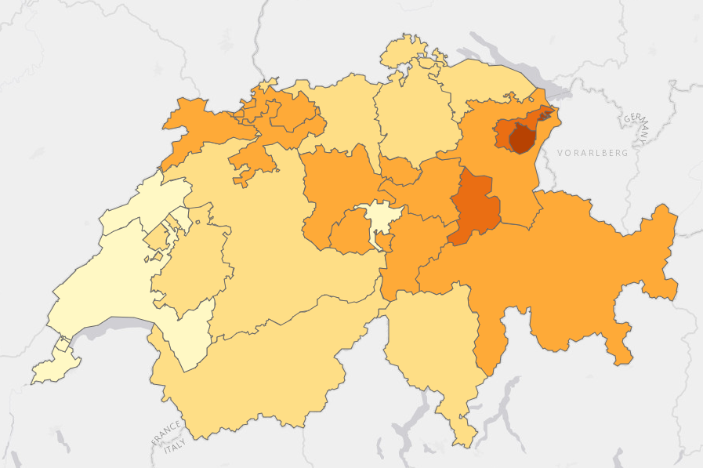
Data
Swiss Household Panel: https://forscenter.ch/projects/swiss-household-panel/
Wave 22 in year 2020
Selected Variables for my final CAS project „SatisMap“
Age, sex, partner
Socioeconomic status, income, education level, work status, Number of own kids
Satisfaction with life, finances, job, freetime (1-10)
Gender Equality attitudes (1-10)
Notes:
For income, i winsorized the upper extreme values

Slide 3
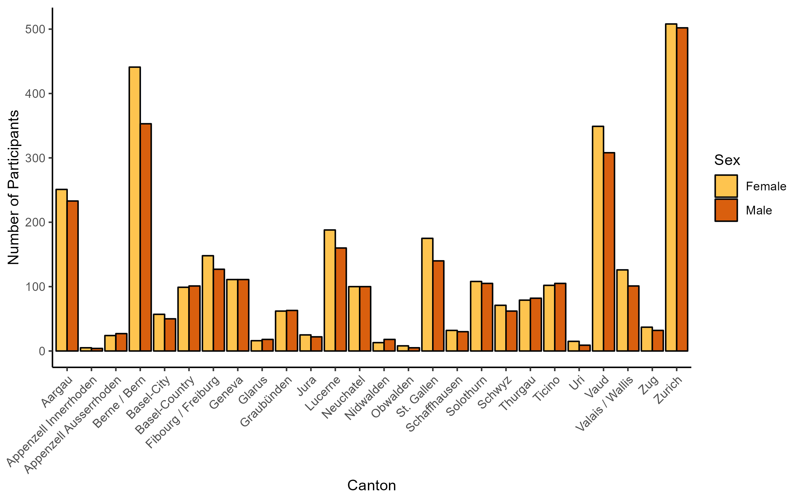
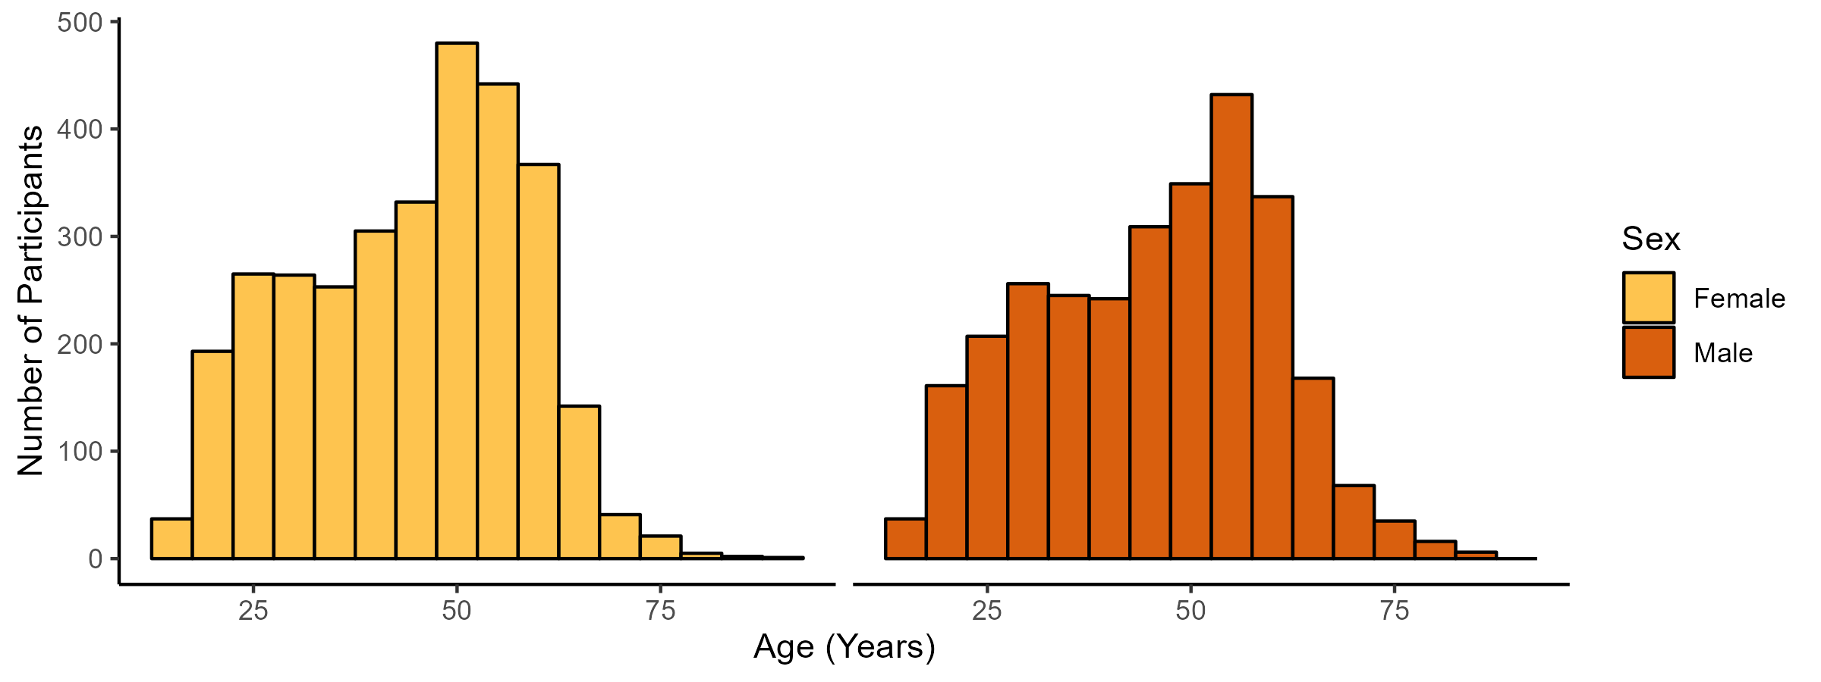
Some Descriptives
N = 6018 (no NAs)
4941 in a relationship

Slide 4
Objective
Use Machine Learning to explore Swiss panel data:
What Features impact Life Satisfaction the most?
How can the Features of the Panel Data be reduced?
What Clusters of Individuals can be found in the Panel Data?

